Slide 1
BITS Pilani
Dr. Lavika Goel
Assistant Professor
Department of CSIS
Lecture 7: 3/3/2019
Pilani Campus

Slide 2
Topics
Text Clustering
Flat Clustering
K-means
Hierarchical Clustering
3/2/2019 SS ZG537 (INFORMATION RETRIEVAL) 2

Slide 3
Clustering
Clustering algorithms group a set of documents into subsets or clusters
The algorithms’ goal is to create clusters that are coherent internally, but clearly different from each other
Documents within a cluster should be as similar as possible
Intracluster distance should be minimum
Documents in one cluster should be as dissimilar as possible from documents in other clusters
Intercluster distance should be maximum.
3/2/2019 SS ZG537 (INFORMATION RETRIEVAL) 3

Slide 4
Clustering
The commonest form of unsupervised learning
Unsupervised learning = learning from raw data
A common and important task that finds many applications in IR and other places
3/2/2019 SS ZG537 (INFORMATION RETRIEVAL) 4

Slide 5
Classification vs. Clustering
Classification: supervised learning
Clustering: unsupervised learning
Classification: Classes are human-defined and part of the input to the learning algorithm.
Clustering: Clusters are inferred from the data without human input.
However, there are many ways of influencing the outcome of clustering: number of clusters, similarity measure, etc.
3/2/2019 SS ZG537 (INFORMATION RETRIEVAL) 5

Slide 6
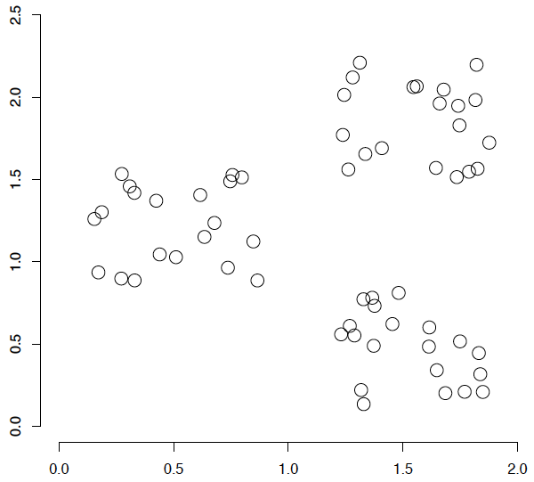
A data set with clear cluster structure
Ch. 16
How to design an algorithm for finding the three clusters in this case?
3/2/2019 SS ZG537 (INFORMATION RETRIEVAL) 6

Slide 7
Cluster hypothesis
Documents in the same cluster behave similarly with respect to relevance to information needs.
If there is a document from a cluster that is relevant to a search request, then it is likely that other documents from the same cluster are also relevant. This is because clustering puts together documents that share many terms.
3/2/2019 SS ZG537 (INFORMATION RETRIEVAL) 7

Slide 8
Why Text Clustering?
To improve retrieval recall
When a query matches a doc d, also return other docs in the cluster containing d. Hope if we do this, the query “car” will also return docs containing “automobile”.
To improve retrieval speed
Cluster Pruning: consider only documents in a small number of clusters as candidates for which we compute similarity scores.
3/2/2019 SS ZG537 (INFORMATION RETRIEVAL) 8

Slide 9
Flat vs. Hierarchical clustering
Flat algorithms
Usually start with a random (partial) partitioning of docs into groups
Refine iteratively
Example: K-means
Hierarchical algorithms
Create a hierarchy
Bottom-up, agglomerative
Top-down, divisive
3/2/2019 SS ZG537 (INFORMATION RETRIEVAL) 9

Slide 10
Hard vs. Soft clustering
Hard clustering: Each document belongs to exactly one cluster.
More common and easier to do
Example: K-Means
Soft clustering: A document can belong to more than one cluster.
Makes more sense for applications like creating browsable hierarchies
Can be done only with a soft clustering approach.
Example: Expectation Maximization (EM)
3/2/2019 SS ZG537 (INFORMATION RETRIEVAL) 10

Slide 11
Flat algorithms
We can define the goal in hard flat clustering as follows.
Given (i) a set of documents D = {d1, . . . , dN},
(ii) a desired number of clusters K, and
(iii) an objective function that evaluates the quality of a clustering, we want to compute an assignment γ : D → {1, . . . , K} that minimizes the objective function.
Also γ is surjective, i.e., that none of the K clusters is empty
3/2/2019 SS ZG537 (INFORMATION RETRIEVAL) 11

Slide 12
Flat algorithms
Flat algorithms compute a partition of N documents into a set of K clusters.
Given: a set of documents and the number K
Find: a partition into K clusters that optimizes the chosen partitioning criterion
Global optimization: exhaustively enumerate partitions, pick optimal one
Effective heuristic method: K-means algorithm
3/2/2019 SS ZG537 (INFORMATION RETRIEVAL) 12

Slide 13
K-means
The best known clustering algorithm
Simple, works well in many cases
Used as default for clustering documents
Document representations in clustering
Vector space model
As in vector space classification, we measure relatedness between vectors by Euclidean distance or cosine similarity.
3/2/2019 SS ZG537 (INFORMATION RETRIEVAL) 13

Slide 14
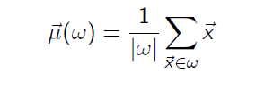
K-means: Basic idea
Each cluster in K-means is defined by a centroid.
Objective/partitioning criterion: minimize the average squared difference from the centroid
Definition of centroid:
where we use ω to denote a cluster.
We try to find the minimum average squared difference by iterating two steps:
reassignment: assign each vector to its closest centroid
recomputation: recompute each centroid as the average of the vectors that were assigned to it in reassignment
3/2/2019 SS ZG537 (INFORMATION RETRIEVAL) 14

Slide 15
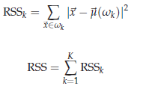
RSS
A measure of how well the centroids represent the members of their clusters is the Residual Sum of Squares or RSS, the squared distance of each vector from its centroid summed over all vectors
RSS is the objective function in K-means and our goal is to minimize it.
3/2/2019 SS ZG537 (INFORMATION RETRIEVAL) 15

Slide 16
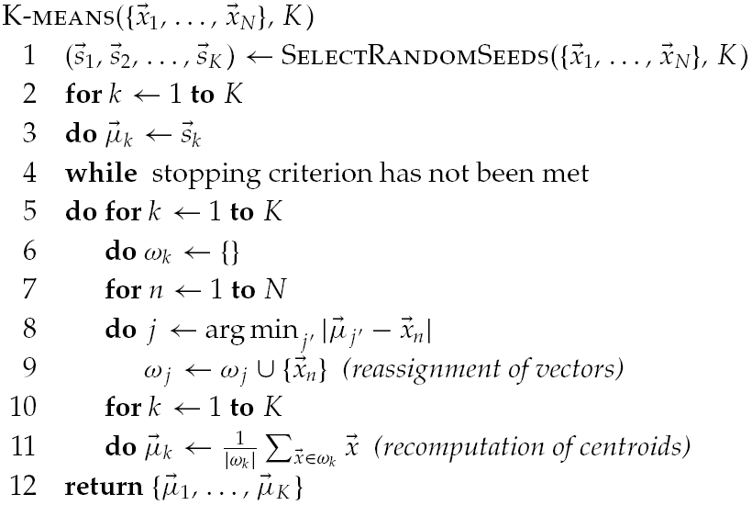
K-means Algorithm
3/2/2019 SS ZG537 (INFORMATION RETRIEVAL) 16

Slide 17
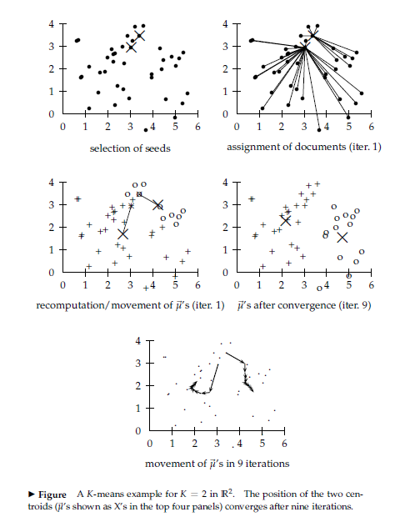
Example

Slide 18
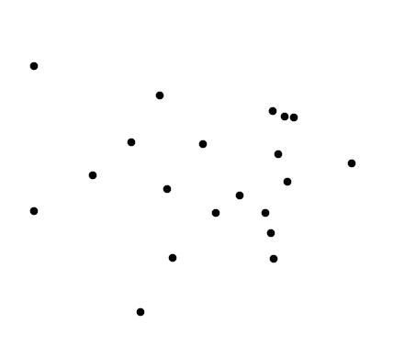
Example
Set of points to be clustered
3/2/2019 SS ZG537 (INFORMATION RETRIEVAL) 18

Slide 19
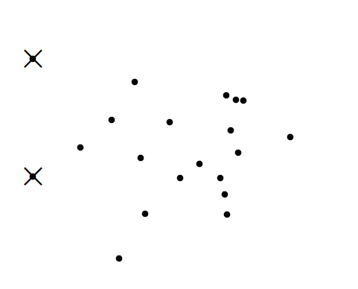
Example
Random selection of initial centroids
3/2/2019 SS ZG537 (INFORMATION RETRIEVAL) 19

Slide 20
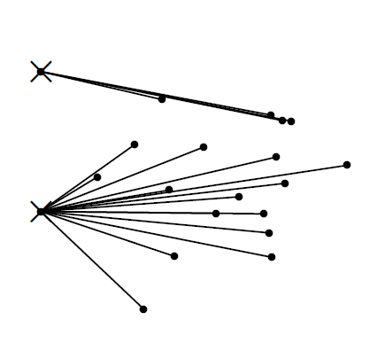
Example
Assign points to closest centroid
3/2/2019 SS ZG537 (INFORMATION RETRIEVAL) 20

Slide 21
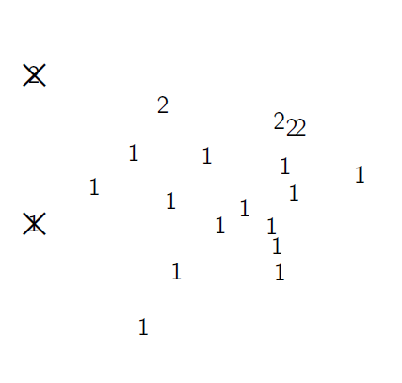
Example
Assignment
3/2/2019 SS ZG537 (INFORMATION RETRIEVAL) 21

Slide 22
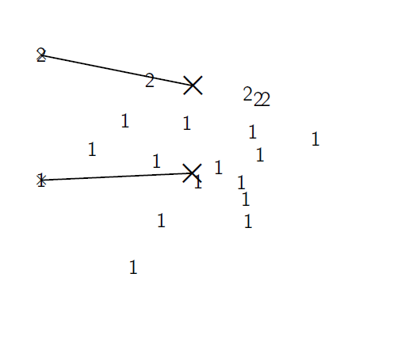
Example
Recompute cluster centroids
3/2/2019 SS ZG537 (INFORMATION RETRIEVAL) 22

Slide 23
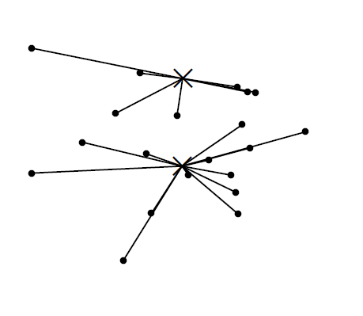
Example
Assign points to closest centroid
3/2/2019 SS ZG537 (INFORMATION RETRIEVAL) 23

Slide 24
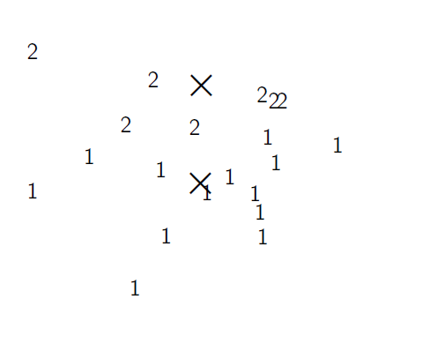
Example
Assignment
3/2/2019 SS ZG537 (INFORMATION RETRIEVAL) 24

Slide 25
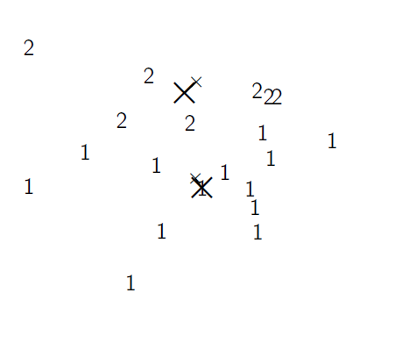
Example
Recompute cluster centroids
3/2/2019 SS ZG537 (INFORMATION RETRIEVAL) 25

Slide 26
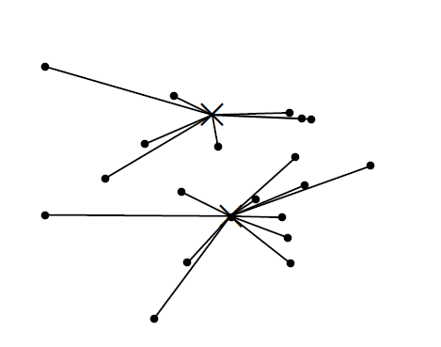
Example
Assign points to closest centroid
3/2/2019 SS ZG537 (INFORMATION RETRIEVAL) 26

Slide 27
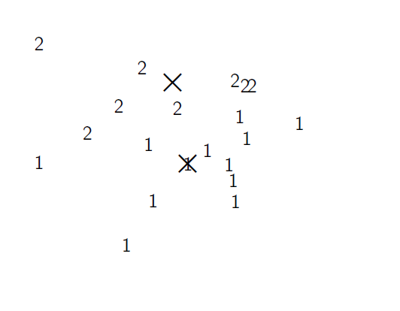
Example
Assignment
3/2/2019 SS ZG537 (INFORMATION RETRIEVAL) 27

Slide 28
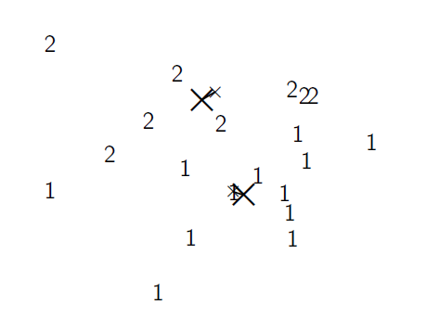
Example
Recompute cluster centroids
3/2/2019 SS ZG537 (INFORMATION RETRIEVAL) 28

Slide 29
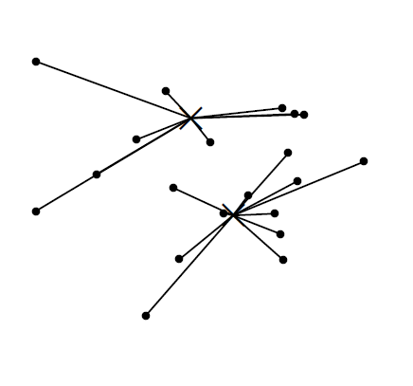
Example
Assign points to closest centroid
3/2/2019 SS ZG537 (INFORMATION RETRIEVAL) 29

Slide 30
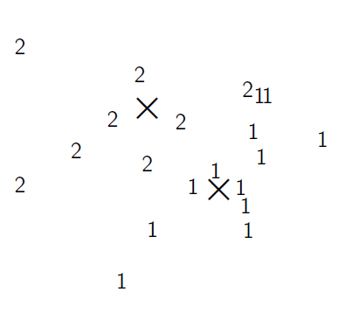
Example
Assignment
3/2/2019 SS ZG537 (INFORMATION RETRIEVAL) 30

Slide 31
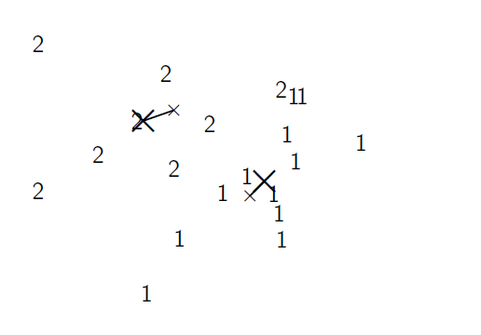
Example
Recompute cluster centroids
3/2/2019 SS ZG537 (INFORMATION RETRIEVAL) 31

Slide 32
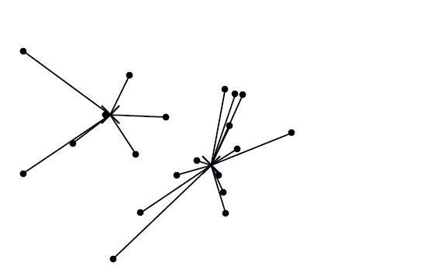
Example
Assign points to closest centroid
3/2/2019 SS ZG537 (INFORMATION RETRIEVAL) 32

Slide 33
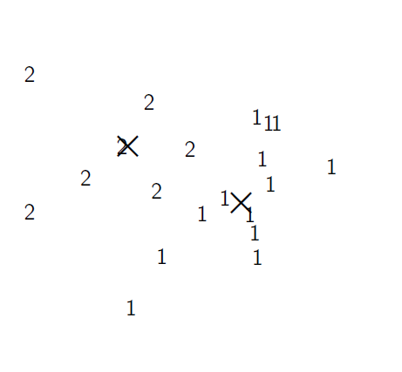
Example
Assignment
3/2/2019 SS ZG537 (INFORMATION RETRIEVAL) 33

Slide 34
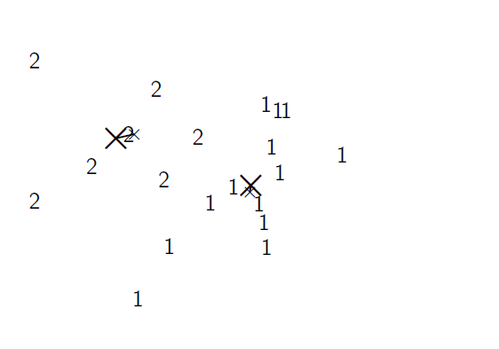
Example
Recompute cluster centroids
3/2/2019 SS ZG537 (INFORMATION RETRIEVAL) 34

Slide 35
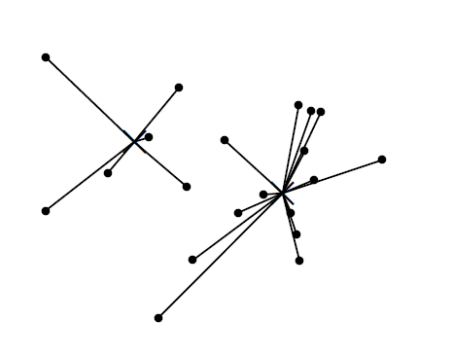
Example
Assign points to closest centroid
3/2/2019 SS ZG537 (INFORMATION RETRIEVAL) 35

Slide 36
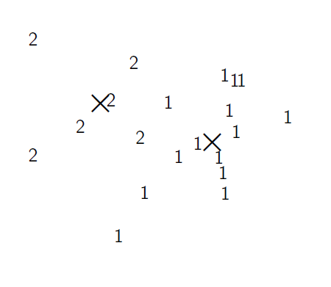
Example
Assignment
3/2/2019 SS ZG537 (INFORMATION RETRIEVAL) 36

Slide 37
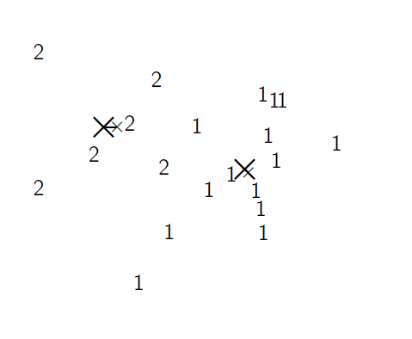
Example
Recompute cluster centroids
3/2/2019 SS ZG537 (INFORMATION RETRIEVAL) 37

Slide 38
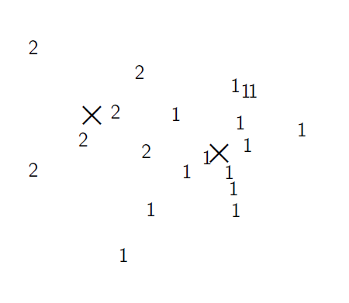
Example
Centroids and Assignments after convergence
3/2/2019 SS ZG537 (INFORMATION RETRIEVAL) 38

Slide 39
Termination conditions
Sec. 16.4
A fixed number of iterations
Doc partition unchanged
Centroid positions don’t change
Terminate when RSS falls below a threshold. This criterion ensures that the clustering is of a desired quality after termination
3/2/2019 SS ZG537 (INFORMATION RETRIEVAL) 39

Slide 40
K-means is guaranteed to converge
RSS = sum of all squared distances between document vector and closest centroid
RSS decreases during each reassignment / recomputation step.
There is only a finite number of clustering.
Thus: We must reach a fixed point.
Finite set & monotonically decreasing → convergence
3/2/2019 SS ZG537 (INFORMATION RETRIEVAL) 40

Slide 41
Optimality of K-means
Convergence ≠ optimality
Convergence does not mean that we converge to the optimal clustering!
This is the great weakness of K-means.
If we start with a bad set of seeds, the resulting clustering can be horrible.
3/2/2019 SS ZG537 (INFORMATION RETRIEVAL) 41

Slide 42

Seed Choice
Sec. 16.4
Example showing
sensitivity to seeds
In the above, if you start
with B and E as centroids
you converge to {A,B,C}
and {D,E,F}
If you start with D and F
you converge to
{A,B,D,E} {C,F}
3/2/2019 SS ZG537 (INFORMATION RETRIEVAL) 42

Slide 43

K-means: Exercise 1
Given a set of five points {1, 2, 3, 4, 5} on an axis, what clusters will the k-means clustering algorithm (with k=2) produce, if 4 and 5 are chosen as the two initial seeds? Use Euclidean distance as distance metric.
3/2/2019 SS ZG537 (INFORMATION RETRIEVAL) 43

Slide 44
K-means: Exercise 1
Step (1)
centres: 4 and 5
clusters: {1, 2, 3, 4} and {5}
Step (2)
centres: 2.5 and 5
clusters: {1, 2, 3} and {4, 5}
Step (3)
centres: 2 and 4.5
clusters: {1, 2, 3} and {4, 5}
3/2/2019 SS ZG537 (INFORMATION RETRIEVAL) 44

Slide 45
K-means: Exercise 2
Cluster to following documents using K-means with K=2
Doc1: “fly eagle”
Doc2: “go eagle fly”
Doc3: “eagle fly eagle”
Doc4: “go fly”
Doc5: “go eagle”
Assume Doc1 and Doc3 are chosen as initial seeds. Use tf (without idf and normalization) and Euclidean distance. Assume the words in the vectors are ordered alphabetically.
Show the clusters and their centroids for each iteration. How many iterations are needed for the algorithm to converge
3/2/2019 SS ZG537 (INFORMATION RETRIEVAL) 45

Slide 46
What is a good clustering?
Internal criteria
High intra-cluster similarity
Low inter-cluster similarity
But an internal criterion often does not evaluate the actual utility of a clustering in the application.
Alternative: External criteria
Evaluate with respect to a human-defined classification
3/2/2019 SS ZG537 (INFORMATION RETRIEVAL) 46

Slide 47
What is a good clustering?
External criteria for clustering quality
Based on a gold standard data set, e.g., the Reuters collection
Goal: Clustering should reproduce the classes in the gold standard
But we only want to reproduce how documents are divided into groups, not the class labels.
3/2/2019 SS ZG537 (INFORMATION RETRIEVAL) 47

Slide 48
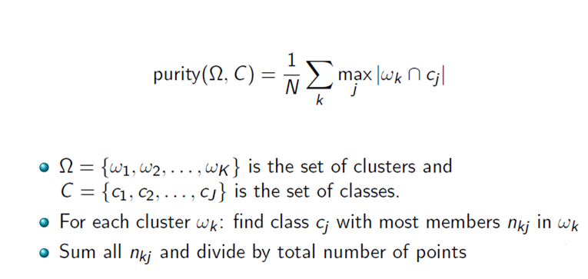
Purity
First measure for how well we were able to reproduce the classes
3/2/2019 SS ZG537 (INFORMATION RETRIEVAL) 48

Slide 49
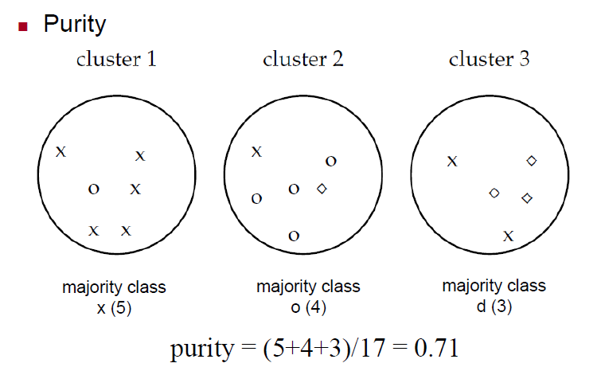
Purity
First measure for how well we were able to reproduce the classes
3/2/2019 SS ZG537 (INFORMATION RETRIEVAL) 49

Slide 50

Purity
High purity is easy to achieve when the number of clusters is large – in particular, purity is 1 if each document gets its own cluster.
Thus, we cannot use purity to trade off the quality of the clustering against the number of clusters
A measure that does not have this problem: Rand index.
3/2/2019 SS ZG537 (INFORMATION RETRIEVAL) 50

Slide 51
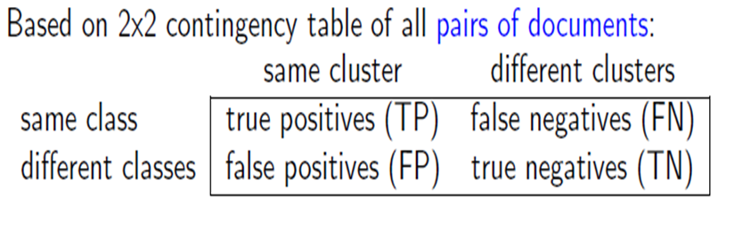
Rand Index
3/2/2019 SS ZG537 (INFORMATION RETRIEVAL) 51

Slide 52
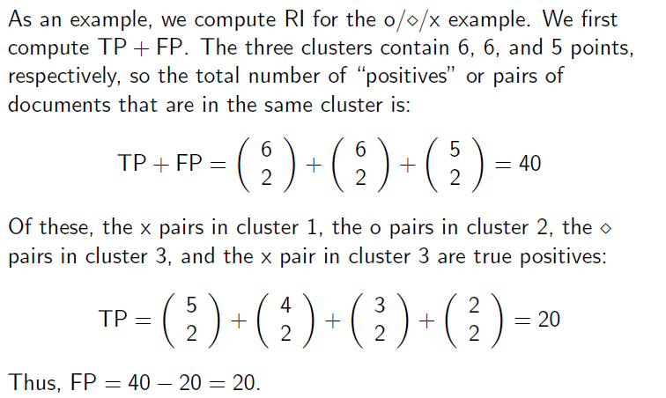
Rand Index
3/2/2019 SS ZG537 (INFORMATION RETRIEVAL) 52

Slide 53
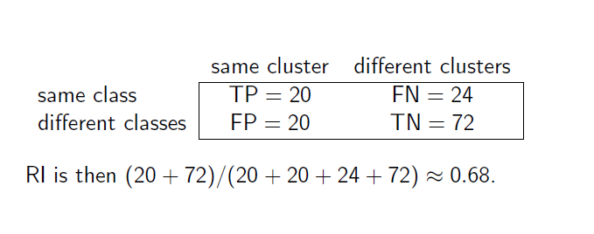
Rand Index
3/2/2019 SS ZG537 (INFORMATION RETRIEVAL) 53

Slide 54
Hierarchical Clustering
It outputs a hierarchy, a structure that is more informative than the unstructured set of clusters returned by flat clustering
Does not require us to pre-specify the number of clusters and most hierarchical algorithms that have been used in IR are deterministic
These advantages come at the cost of lower efficiency
The most common hierarchical clustering algorithms have a complexity that is at least quadratic in the number of documents compared to the linear complexity of K-means.
3/2/2019 SS ZG537 (INFORMATION RETRIEVAL) 54

Slide 55
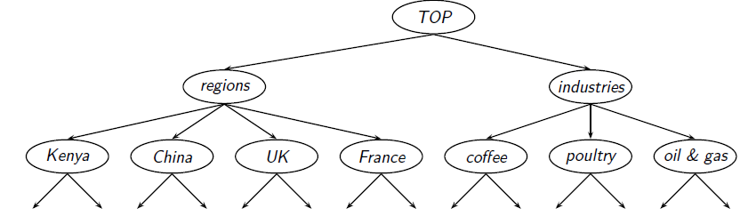
Hierarchical Clustering
Goal in hierarchical clustering is to create a hierarchy like the one in Reuters:
To create this hierarchy automatically.
This can be done either top-down or bottom-up.
The best known bottom-up method is Hierarchical Agglomerative Clustering(HAC).
3/2/2019 SS ZG537 (INFORMATION RETRIEVAL) 55

Slide 56
Hierarchical Clustering
Bottom-up algorithms treat each document as a singleton cluster at the outset and then successively merge (or agglomerate) pairs of clusters until all clusters have been merged into a single cluster that contains all documents.
Bottom-up hierarchical clustering is therefore called Hierarchical Agglomerative Clustering or HAC.
Top-down clustering requires a method for splitting a cluster.
It proceeds by splitting clusters recursively until individual documents are reached.
3/2/2019 SS ZG537 (INFORMATION RETRIEVAL) 56

Slide 57
Hierarchical Agglomerative Clustering (HAC)
Start with each document in a separate cluster
Then repeatedly merge the two clusters that are most similar until there is only one cluster.
Assumes a similarity measure for determining the similarity of two clusters.
The history of merging is a hierarchy in the form of a binary tree.
The standard way of depicting this history is a dendrogram.
3/2/2019 SS ZG537 (INFORMATION RETRIEVAL) 57

Slide 58
Hierarchical Agglomerative Clustering (HAC)
The history of merges can be read off from bottom to top.
The horizontal line of each merge tells us what the similarity of the merged clusters was.
We can cut the dendrogram at a particular point (e.g., at 0.1 with 12 clusters or 0.4 with 24 clusters) to get a flat clustering.
3/2/2019 SS ZG537 (INFORMATION RETRIEVAL) 58

Slide 59
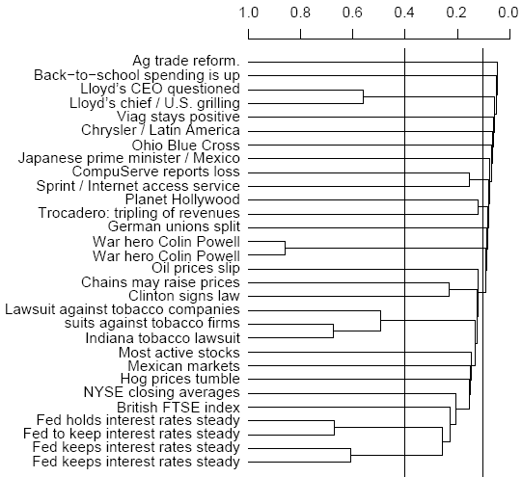
A dendrogram
3/2/2019 SS ZG537 (INFORMATION RETRIEVAL) 59

Slide 60
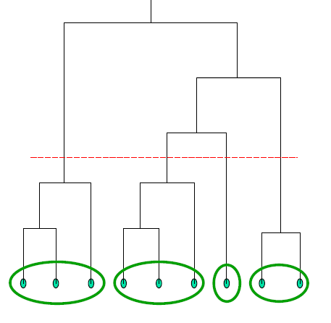
Dendrogram → Clusters
Clustering can be obtained by cutting the dendrogram at a desired level: each connected component forms a cluster.
The number of clusters is not required in advance
3/2/2019 SS ZG537 (INFORMATION RETRIEVAL) 60

Slide 61
Criteria to determine the cut
Cut at a pre-specified level of similarity.
Cut the dendrogram where the gap between two successive combination similarities is largest. Such large gaps arguably indicate “natural” clustering.
As in flat clustering, we can also pre-specify the number of clusters K and select the cutting point that produces K clusters.
3/2/2019 SS ZG537 (INFORMATION RETRIEVAL) 61

Slide 62
Cluster Similarity
Single-link: Maximum similarity
Maximum similarity of any two documents
Complete-link: Minimum similarity
Minimum similarity of any two documents
Centroid: Average similarity of all document pairs (but excluding pairs of docs in the same cluster)
This is equivalent to the similarity of the centroids.
Group-average: Average similarity of all document pairs, including pairs of docs in the same cluster
3/2/2019 SS ZG537 (INFORMATION RETRIEVAL) 62

Slide 63
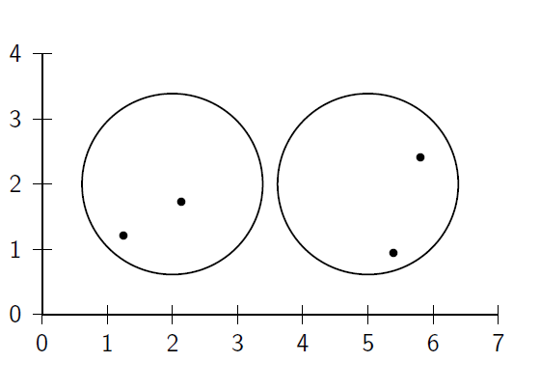
Cluster similarity: Example
3/2/2019 SS ZG537 (INFORMATION RETRIEVAL) 63

Slide 64
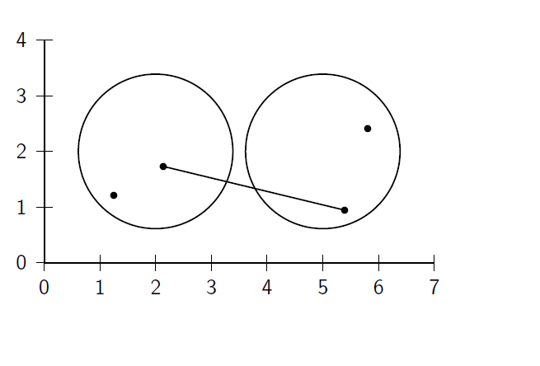
Single Link : Maximum Similarity
3/2/2019 SS ZG537 (INFORMATION RETRIEVAL) 64

Slide 65
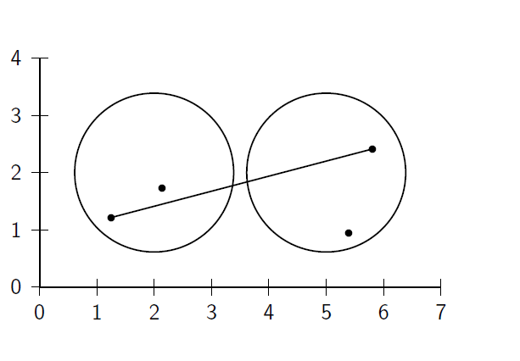
Complete Link : Minimum Similarity
3/2/2019 SS ZG537 (INFORMATION RETRIEVAL) 65

Slide 66
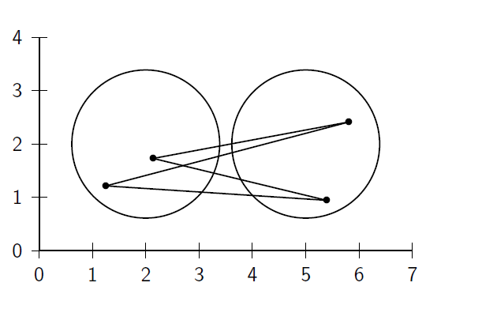
Centroid: Average Intersimilarity
3/2/2019 SS ZG537 (INFORMATION RETRIEVAL) 66

Slide 67
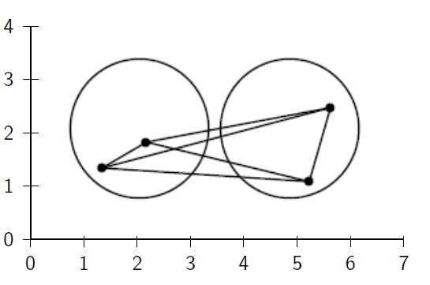
Group Average: Average of all similarities
3/2/2019 SS ZG537 (INFORMATION RETRIEVAL) 67

Slide 68
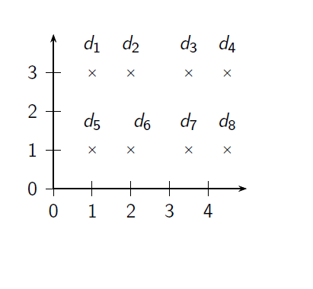
Exercise: Compute single and complete link clustering
3/2/2019 SS ZG537 (INFORMATION RETRIEVAL) 68

Slide 69
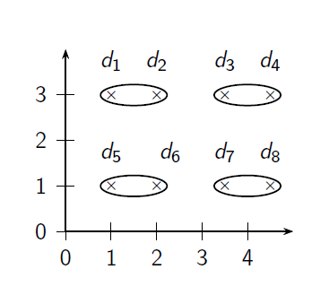
Single-link clustering
3/2/2019 SS ZG537 (INFORMATION RETRIEVAL) 69

Slide 70
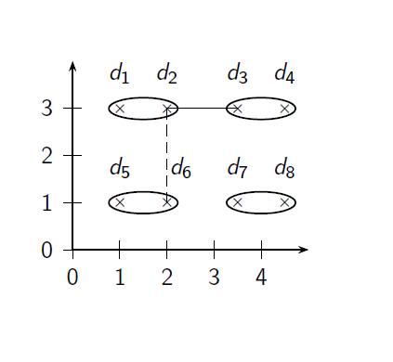
Single-link clustering
3/2/2019 SS ZG537 (INFORMATION RETRIEVAL) 70

Slide 71
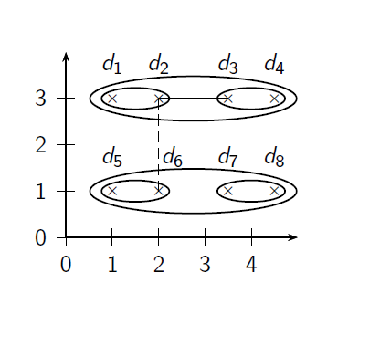
Single-link clustering
3/2/2019 SS ZG537 (INFORMATION RETRIEVAL) 71

Slide 72
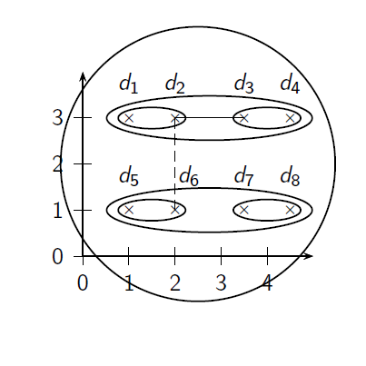
Single-link clustering
3/2/2019 SS ZG537 (INFORMATION RETRIEVAL) 72

Slide 73
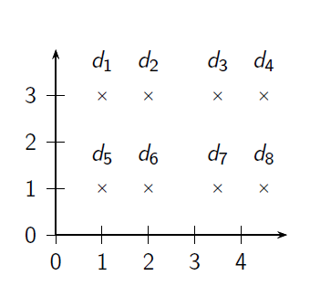
Complete link clustering
3/2/2019 SS ZG537 (INFORMATION RETRIEVAL) 73

Slide 74
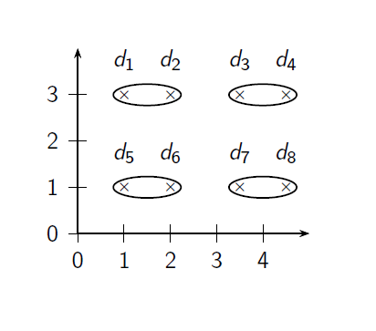
Complete link clustering
3/2/2019 SS ZG537 (INFORMATION RETRIEVAL) 74

Slide 75
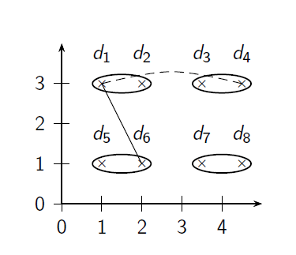
Complete link clustering
3/2/2019 SS ZG537 (INFORMATION RETRIEVAL) 75

Slide 76
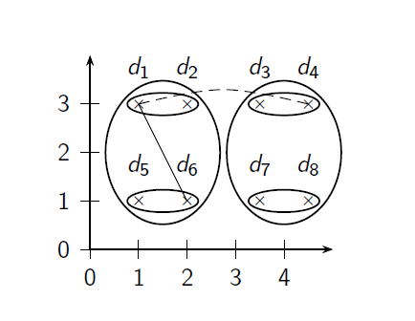
Complete link clustering
3/2/2019 SS ZG537 (INFORMATION RETRIEVAL) 76

Slide 77
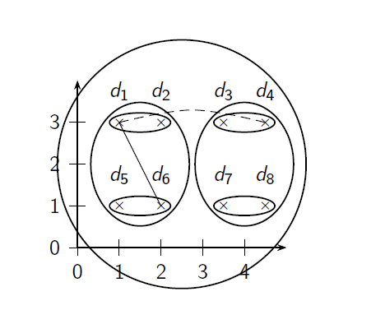
Complete link clustering
3/2/2019 SS ZG537 (INFORMATION RETRIEVAL) 77

Slide 78
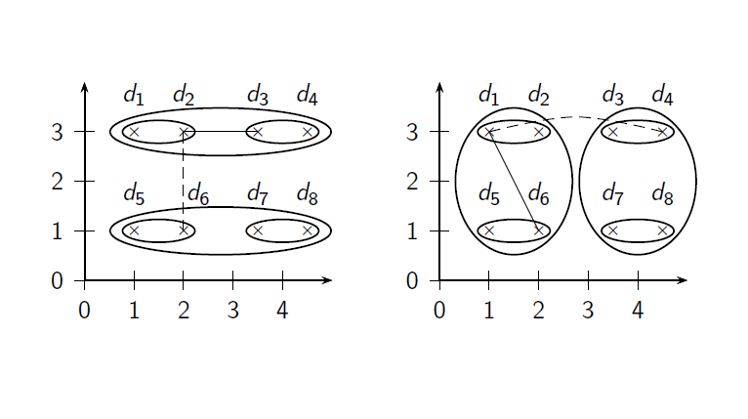
Single-link vs. Complete link clustering
3/2/2019 SS ZG537 (INFORMATION RETRIEVAL) 78

Slide 79

Centroid HAC
The similarity of two clusters is the average similarity of documents from the first cluster with documents from the second cluster.
The definition is equivalent to computing the similarity of the centroids
The clusters to be merged are the clusters with the highest centroid similarities.
3/2/2019 SS ZG537 (INFORMATION RETRIEVAL) 79

Slide 80

Centroid HAC
3/2/2019 SS ZG537 (INFORMATION RETRIEVAL) 80

Slide 81

Centroid HAC
3/2/2019 SS ZG537 (INFORMATION RETRIEVAL) 81

Slide 82

Centroid HAC
3/2/2019 SS ZG537 (INFORMATION RETRIEVAL) 82

Slide 83

Centroid HAC
3/2/2019 SS ZG537 (INFORMATION RETRIEVAL) 83

Slide 84
Group-average agglomerative clustering (GAAC)
The similarity of two clusters is the average similarity of all document pairs including those from the same cluster but self-similarities are not included in the average:
3/2/2019 SS ZG537 (INFORMATION RETRIEVAL) 84

